Slide 1
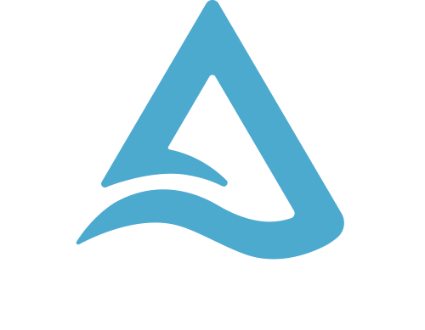
WORKSHOP
Hari Gopinath
Sr. Solutions Consultant

Slide 2


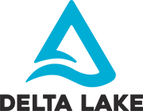


A unified data analytics platform for accelerating innovation across
data engineering, data science, and analytics
Global company with over 5,000 customers and 450+ partners
Original creators of popular data and machine learning open source projects
Notes:
Key Takeaways:
Software company that provides a unified platform for data teams - data engineering, data science and analytics
Proven track record of delivering value and a strong global partner ecosystem
Establish credibility with Spark, and we continue to be an innovation engine in the open source ecosystem with Delta Lake, MLflow and Redash.... We will continue to do more.
Detailed Talk Track:
Today we're going to talk about Databricks. We will talk about who the company is, how we got started, who are customers are and what business value that they're gaining by leveraging our platform. Then we will get into the technology and how we're enabling the business outcomes that our customers are getting.
Databricks is a software company. It’s managed service or a SAAS company that has a Unified Data Analytics Platform that really allows three core data personas to come together to collaborate and drive business outcomes with their data. The key personas that we deal with are Data Engineers, Data Scientists and Data Analysts.
If you're one of those three personas, you're a perfect candidate for the Databricks platform. What we do is we will allow for a collaborative environment for those three corporate personas to come together and drive business outcomes with your data. I'll talk about an example or two of what a business outcome with your data is.
Databricks has over 5,000 customers and 450 partners in the data ecosystem. A lot of people will come up to me and say, “isn’t Databricks synonymous with Spark? Aren't you the folks that created Spark? Aren't you the folks that you know teach Spark and do consulting on Spark?”
Yes, are roots did come from Spark. Back in 2009, there was six folks at the Berkeley AMP Lab that felt at the time, Big Data the Big Data ecosystem was failing large enterprises and that big data ecosystem was built on Hadoop: HDFS and MapReduce, which was difficult to deal with. The APIs were slow for MapReduce, and APIs were difficult to develop against with MapReduce.
These six folks from Berkeley felt like they could build something better, so they came up with Spark. When you fast forward today, Spark is the defacto standard for Big Data processing as it relates to Machine Learning and Deep Learning.
Our company was founded in 2013. Spark was donated to the Apache foundation at the time and our six founders were the original six co-creators of Spark. Outside of Spark we've also contributed some really awesome projects to the Open Source data community and one of those is Delta Lake. At the highest level, a lot of these data lakes that were built on Hadoop turned into data swamps. What Delta like aims for is to bring reliability and scalability to those data lakes, really turning those swamps back into purified water that you can drink and swim in.
We also launched MLflow about a year and a half ago. MLflow is still the only Open Source machine learning governance and lifecycle management platform out there today. Anywhere from “how do I track my experiments that I'm running” up to machine learning experience, all the way to “how do I build a promotion path from dev staging to test with my ML models” and “what are those approval gates that I have to go through”, this is what MLflow aims to support. Think of CICD for ML and deep learning models.
We recently acquired Redash, an open source company that provides an easy-to-use dashboarding and visualization solution focussed on SQL analysts. It has more than 7K deployments globally and we are excited to welcome data analysts into our broad and growing open source ecosystem. Redash makes it very easy for our customers to generate insights using SQL on all the data in Delta Lake.

Slide 3
What this is not going to be? (well hopefully🤞)
Just another demo session
Sales pitch
Strategic marketing of new technologies
A course that just runs in the background while you carry on doing your daily job
A 3 hour lecture 🤓

Slide 4
Audience
Beginner/intermediate in Big Data/Cloud
Beginner/intermediate in Spark/Databricks
Good knowledge in SQL
Fair knowledge of programming (python)

Slide 5
Agenda
Why Lakehouse?
Challenges of Data Lakes
Introduction to Lakehouse
The medallion approach - Bronze, silver, Gold
How Delta Lake overcomes challenges of Conventional Data lake
Getting started with Delta Lake
Schema Evolution / Schema Enforcement - what is it ? when to to use what?
How to perform merge?
Autoloader - How to use it?
Delta - Best Practices
Optimisation tips

Slide 6
Why Lakehouse?
Notes:
Why lakehouse? Lets take a step back and look at the emergence of Data Lake and top challenges working with conventional Data Lakes.

Slide 7





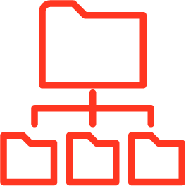
The Emergence of Data Lakes
Really cheap, durable storage 10 nines of durability. Cheap. Infinite scale.
Store all types of raw data Video, audio, text, structured, unstructured
Open, standardized formats Parquet format, big ecosystem of tools operate on these file formats

Slide 8
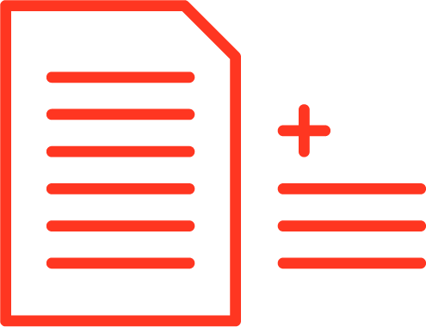
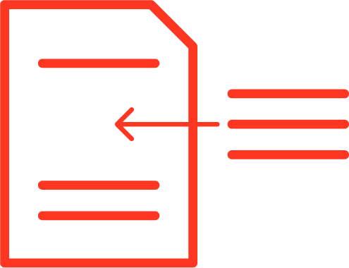
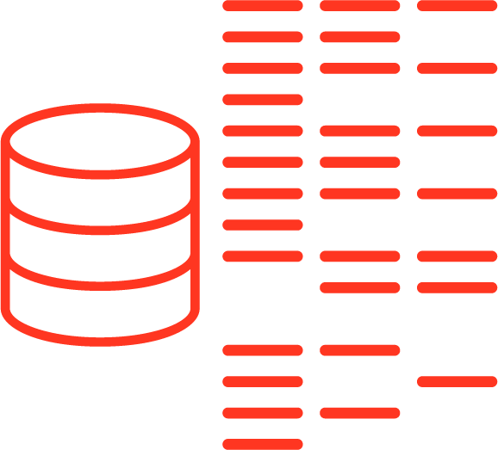
Challenges with data lakes
1. Hard to append data Adding newly arrived data leads to incorrect reads
2. Modification of existing data is difficult GDPR/CCPA requires making fine grained changes to existing data lake
3. Jobs failing mid way Half of the data appears in the data lake, the rest is missing
Notes:
The first one is that something as simple as just appending new data using Spark into the data lake while at the same time trying to read it consistently has caused a ton of issues. Users want their changes to appear all at once. However this was hard to achieve, because making multiple files appear all at once, or even a single file to appear in its full form was not supported out of the box with Data Lakes.
Second, modification of data is hard. Especially with GDPR and CCPA, it's required that if a user does not want their data to be stored, you have to be able to delete it. And if you have it in the data lake, how do you delete the single record? It's very costly to do with Spark. Some would come up with manual techniques for this, but it would rewrite entire petabytes on the data lake once a week to sort of clean it of the things that needed to be removed.
Third is the issue of jobs failing midway through. So sometimes you have a streaming job, it fails, the cluster goes down and then months later when you're trying to access the data, it turns out only half of the data is there.

Slide 9


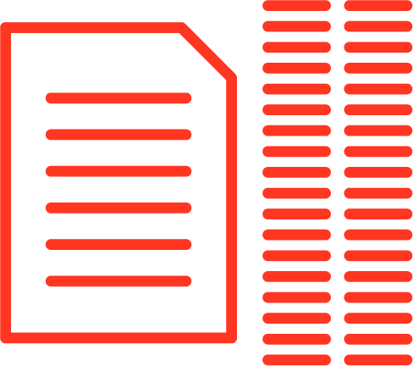
Challenges with data lakes
4. Real-time operations Mixing streaming and batch leads to inconsistency
5. Costly to keep historical versions of the data Regulated environments require reproducibility, auditing, governance
6. Difficult to handle large metadata For large data lakes the metadata itself becomes difficult to manage
Notes:
Fourth, organizations have been promised that they can mix real time operations and do these things on these systems. But it turns out that mixing streaming and batch leads to inconsistency. This is a variation of the first problem with appends, but mixing real time operations and batch leads to inconsistencies where you’re reading partial results.
Fifth, many regulated organizations need to keep all the versions of their data and they need to reproduce any dataset they ever had for auditing and governance reasons. It turns out that this is very hard to do. So what they would do is, again, manually make lots of copies and snapshots of the data. This is time intensive, but also really costly.
The sixth challenge we see is that it’s really difficult to handle large metadata. If you have petabytes of data in the data lake, then the metadata itself becomes gigabytes and most of the catalogs out there cannot support those sizes.

Slide 10
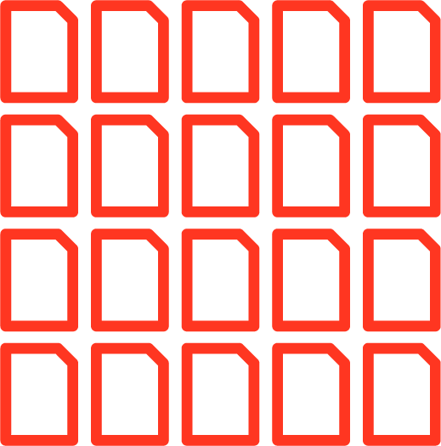
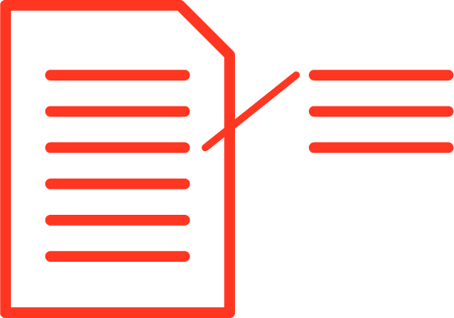

Challenges with data lakes
7. “Too many files” problems Data lakes are not great at handling millions of small files
8. Hard to get great performance Partitioning the data for performance is error-prone and difficult to change
9. Data quality issues It’s a constant headache to ensure that all the data is correct and high quality
Notes:
Seven, the "too many files" problem. Again, since data lakes are file based you end up with maybe millions of tiny files or maybe you have two really gigantic files. In either case, this impacts performance.
Eight, on that same note, it’s just generally hard to get great performance. You have to do a lot of manual techniques like partitioning and these techniques are of course error prone.
Last but not least, all of these issues eventually lead up to data quality issues. It’s really hard to ensure that your data is correct and clean. It’s especially hard in the big data world, because you can’t skim through your data manually to see if it looks okay.

Slide 11




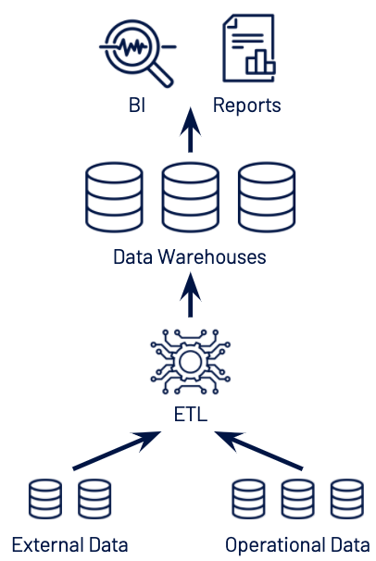
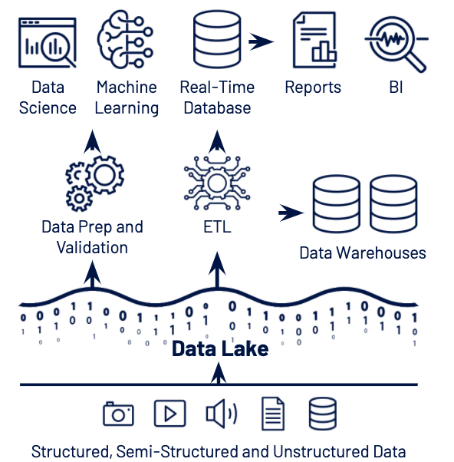
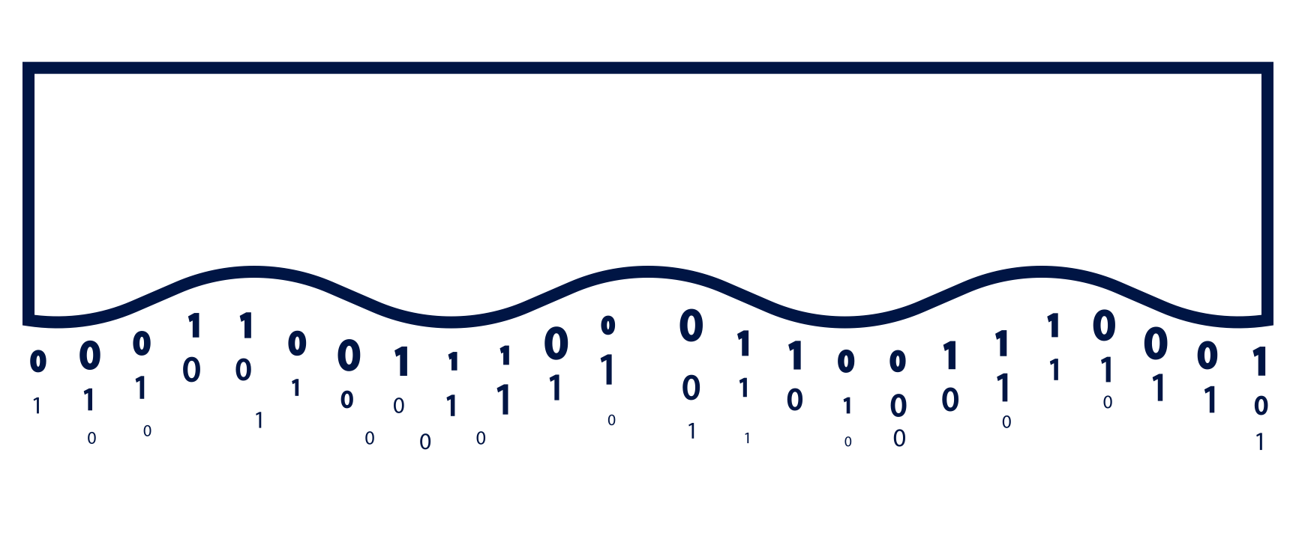

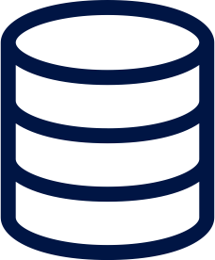




Introducing Lakehouse
https://databricks.com/blog/2020/01/30/what-is-a-data-lakehouse.html
Data Warehouse
Data Lake
BI
Streaming Analytics
Data Science
Machine Learning
Structured, Semi-Structured and Unstructured Data
Notes:
This is what we call the LAKEHOUSE PARADIGM
BEST OF BOTH WORLDS
STRUCTURE, BI, REPORTING, with DATA SCIENCE, ML/AI, STREAMING, ALL DATA

Slide 12










Lakehouse Platform
SIMPLE OPEN COLLABORATIVE
Data Engineering
BI & SQL
Analytics
Real-time Data Applications
Data Science
& Machine Learning
Data Management & Governance
Open Data Lake
Structured
Semi-structured
Unstructured
Streaming

Slide 13
Notes:
Next, we will explore this architecture as implemented with Delta Lake and why it is the best option for building an EDSS.
(CLICK TO MOVE ON TO NEXT SLIDE)

Slide 14
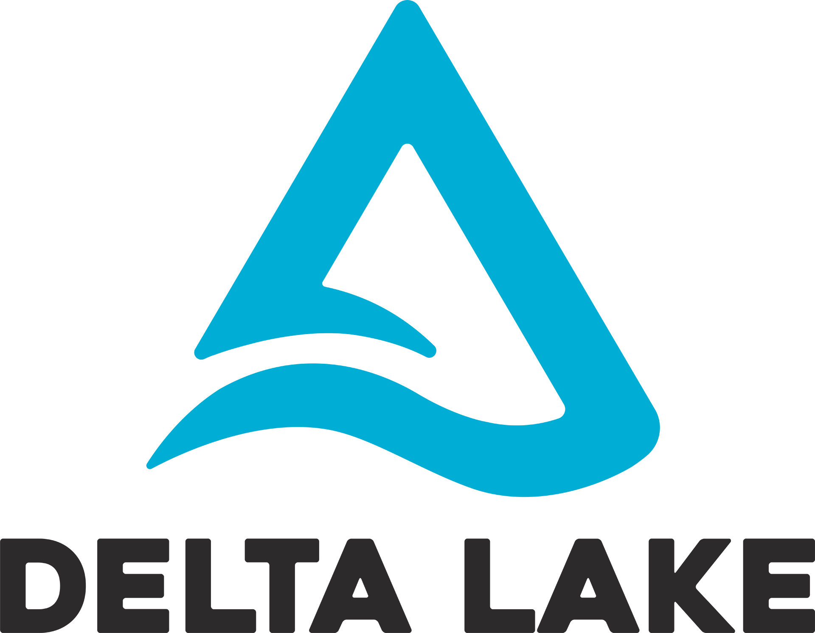
A new standard for building data lakes
An opinionated approach to building Data Lakes
Adds reliability, quality, performance to Data Lakes
Brings the best of data warehousing and data lakes
Builds on an open format (parquet) and adds an open source transaction log

Slide 15



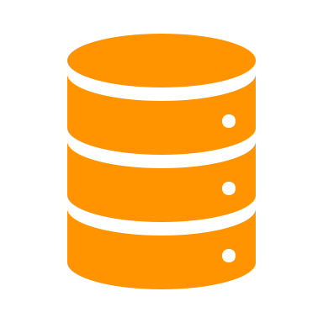




The Delta Lake -- Multihop architecture
Bronze
Silver
Gold
Streaming Analytics
CSV,
JSON, TXT…
Data Lake
AI & Reporting
Data quality

Slide 16
Delta architecture - Bronze
Bronze
CSV,
JSON, TXT…
Data Lake
Raw Ingestion

Slide 17
Delta architecture - Silver
Bronze
Silver
CSV,
JSON, TXT…
Data Lake
Filtered Cleaned
Augmented

Slide 18
Delta architecture - Gold
Bronze
Silver
Gold
Streaming Analytics
CSV,
JSON, TXT…
Data Lake
Business- level aggregates
AI & Reporting
Data quality

Slide 19
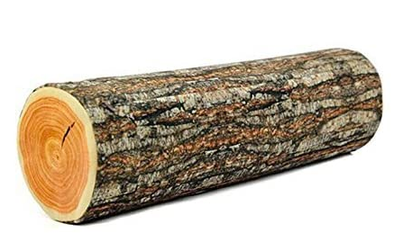
How Delta Lake overcomes Data Lake Challenges
ACID Transactions
Atomicity, Consistency, Isolation, Durability
Hard to append data
Modification of existing data difficult
Jobs failing mid way
Real-time operations hard
Costly to keep historical data versions
Difficult to handle large metadata
“Too many files” problems
Poor performance
Data quality issues
Make every operation transactional
It either fully succeeds - or it is fully aborted for later retries
/path/to/table/_delta_log
0000.json
0001.json
0002.json
…
0010.parquet

Slide 20
How Delta Lake overcomes Data Lake Challenges
ACID Transactions
Hard to append data
Modification of existing data difficult
Jobs failing mid way
Real-time operations hard
Costly to keep historical data versions
Difficult to handle large metadata
“Too many files” problems
Poor performance
Data quality issues
Make every operation transactional
It either fully succeeds - or it is fully aborted for later retries
/path/to/table/_delta_log
0000.json
0001.json
0002.json
…
0010.parquet
{
Add file1.parquet
Add file2.parquet
...

Slide 21
How Delta Lake overcomes Data Lake Challenges
ACID Transactions
Hard to append data
Modification of existing data difficult
Jobs failing mid way
Real-time operations hard
Costly to keep historical data versions
Difficult to handle large metadata
“Too many files” problems
Poor performance
Data quality issues
Make every operation transactional
It either fully succeeds - or it is fully aborted for later retries
/path/to/table/_delta_log
0000.json
0001.json
0002.json
…
0010.parquet
{
Remove file1.parquet
Add file3.parquet
...

Slide 22
How Delta Lake overcomes Data Lake Challenges
ACID Transactions
Hard to append data
Modification of existing data difficult
Jobs failing mid way
Real-time operations hard
Costly to keep historical data versions
Difficult to handle large metadata
“Too many files” problems
Poor performance
Data quality issues
Make every operation transactional
It either fully succeeds - or it is fully aborted for later retries
/path/to/table/_delta_log
0000.json
0001.json
0002.json
…
0010.parquet
0010.json
0011.json

Slide 23
How Delta Lake overcomes Data Lake Challenges
ACID Transactions
Hard to append data
Modification of existing data difficult
Jobs failing mid way
Real-time operations hard
Costly to keep historical data versions
Difficult to handle large metadata
“Too many files” problems
Poor performance
Data quality issues
Make every operation transactional
It either fully succeeds - or it is fully aborted for later retries
Review past transactions
All transactions are recorded and you can go back in time to review previous versions of the data (i.e. time travel)
SELECT * FROM events
TIMESTAMP AS OF ...
SELECT * FROM events
VERSION AS OF ...

Slide 24
How Delta Lake overcomes Data Lake Challenges
Spark under the hood
Hard to append data
Modification of existing data difficult
Jobs failing mid way
Real-time operations hard
Costly to keep historical data versions
Difficult to handle large metadata
“Too many files” problems
Poor performance
Data quality issues
Spark is built for handling large amounts of data
All Delta Lake metadata stored in open Parquet format
Portions of it cached and optimized for fast access
Data and its metadata always co-exist. No need to keep catalog<>data in sync

Slide 25
How Delta Lake overcomes Data Lake Challenges
Indexing
Hard to append data
Modification of existing data difficult
Jobs failing mid way
Real-time operations hard
Costly to keep historical data versions
Difficult to handle large metadata
“Too many files” problems
Poor performance
Data quality issues
Automatically optimize a layout that enables fast access
Partitioning: layout for typical queries
Data skipping: prune files based on statistics on numericals
Z-ordering: layout to optimize multiple columns
Auto-optimize – periodically re-layout data in the background
OPTIMIZE events
ZORDER BY (eventType)

Slide 26
How Delta Lake overcomes Data Lake Challenges
Schema validation, evolution and expectations
Hard to append data
Modification of existing data difficult
Jobs failing mid way
Real-time operations hard
Costly to keep historical data versions
Difficult to handle large metadata
“Too many files” problems
Poor performance
Data quality issues
Schema validation and evolution
All data in Delta Tables have to adhere to a strict schema
Includes schema evolution in merge operations
MERGE INTO events
USING changes
ON events.id = changes.id
WHEN MATCHED THEN
UPDATE SET *
WHEN NOT MATCHED THEN
INSERT *

Slide 27
How Delta Lake overcomes Data Lake Challenges
Schema validation, evolution and expectations
Hard to append data
Modification of existing data difficult
Jobs failing mid way
Real-time operations hard
Costly to keep historical data versions
Difficult to handle large metadata
“Too many files” problems
Poor performance
Data quality issues
Delta Expectations
Additional quality expressions (using SQL)
Every table will at all times satisfy all constraints for the table
CREATE TABLE events (
timestamp TIMESTAMP NOT NULL,
source STRING NOT NULL,
tags MAP<STRING, STRING>)
USING delta

Slide 28


FEATURES
RELIABILITY
PERFORMANCE
Open source
Schema enforcement/Evolution
Unified batch and streaming as a source or sink
Time travel/data snapshots
Update, merge, and delete datasets easily
ACID compliant
Independent compute and storage scaling
Indexing
Automatic optimization and compaction
Data skipping
Caching
Auto-data loader, data expectations, and more to come!

Slide 29
Get started with Delta using Spark APIs
Instead of parquet...
… simply say delta
CREATE TABLE ...
USING parquet
...
dataframe
.write
.format("parquet")
.save("/data")
CREATE TABLE ...
USING delta
…
dataframe
.write
.format("delta")
.save("/data")

Slide 30
Get started with Delta using Spark APIs
Instead of parquet...
… simply say delta
spark
.read
.format("parquet")
.load("/data")
spark
.read
.format("delta")
.load("/data")
Note: When using Databricks version 8 and above, the default format is delta. Hence no need to mention .format(“delta”)

Slide 31
Using Delta with your existing Parquet Tables
Step 1: Convert Parquet to Delta Tables
CONVERT TO DELTA parquet.`path/to/table` [NO STATISTICS] [PARTITIONED BY (col_name1 col_type1, col_name2 col_type2, ...)]
https://docs.microsoft.com/en-us/azure/databricks/spark/latest/spark-sql/language-manual/delta-convert-to-delta

Slide 32
Using Delta with your existing Parquet Tables
Step 2: Optimize layout for fast queries
OPTIMIZE events WHERE date >= current_timestamp() - INTERVAL 1 day ZORDER BY (eventType)
https://docs.microsoft.com/en-us/azure/databricks/delta/optimizations/file-mgmt

Slide 33
Hands on workshop

Slide 34
How MERGE works
Notes:
Things you should know before you productionize your pipeline

Slide 35
What feature are we talking about?
MERGE INTO customers -- Delta table USING updates ON customers.customerId = source.customerId WHEN MATCHED THEN UPDATE SET address = updates.address WHEN NOT MATCHED THEN INSERT (customerId, address) VALUES (updates.customerId, updates.address)

Slide 36
Steps of a MERGE (roughly speaking)
For a more deep dive: https://youtu.be/7ewmcdrylsA
update table and target table
Inner-join between update and target using the condition in the ON clause → Returns to the driver: list of files in target that contain matching rows
Short circuiting happens:
If there were NO matching rows in target in step 1, use an append-only write to append update to target
Else: Use a full-outer-join to consolidate all the changes between update and target
Atomically commit to the Delta transaction log, removing the matching files of step 1 and adding the new files from step 2
What happens if you do this over and over again (e.g. in structured streaming using foreachBatch)?

Slide 37
Side-effects of a MERGE
If we do not have a specific enough condition to MATCH, we are rewriting a lot of data!
If we do have a specific enough condition, we create many many small files every time (because the joins use spark.sql.shuffle.partitions = 200 by default!) → this eventually will break step 1 of the MERGE process when it has to send millions of file paths to the driver
What happens if you do this over and over again (e.g. in structured streaming using foreachBatch)?

Slide 38
Side-effects of a MERGE
Solutions:
We have to think about our data layout of target table so that we do not match 90%+ of the files every time
We can tune down the spark.sql.shuffle.partitions setting before running the optimize (at the cost of write parallelism) in addition to running OPTIMIZE more frequently.
A new feature called “Auto Optimize” (TBD later in the session) handles this automatically.
What happens if you do this over and over again (e.g. in structured streaming using foreachBatch)?

Slide 39
Upserts Hands-on

Slide 40
Schema Enforcement and Evolution

Slide 41
Schema Enforcement and Evolution
Schema enforcement
Default
Schema evolution
Append a DataFrame with evolving schema to a Delta table
Merge a DataFrame with evolving schema to a Delta table
Overwrite a Delta table with a new DataFrame with evolving schema
Notes:
Schema Enforcement is default in Delta.
However at the sametime there are options to enable Schema Evolution on a Delta table.
We will discuss 3 use cases in this section related to Schema Evolution.

Slide 42
Schema evolution
Append a DataFrame with evolving schema to a Delta table
Simple use case for illustration
There is an existing Delta table with 2 columns - id and name.
The latest DataFrame has 3 columns - id, name and year.
Change: a new column has been added to the dataset: year.
The requirement is to append the new data to the existing Delta table and also retain the new column in the Delta table.
df.write
.format("delta")
.mode("append")
.option("mergeSchema", "true")
.saveAsTable("my_delta_table")
https://docs.microsoft.com/en-us/azure/databricks/delta/delta-batch#automatic-schema-update

Slide 43
Schema evolution
Merge a DataFrame with evolving schema to a Delta table
Simple use case for illustration
There is an existing Delta table with 2 columns - id and name.
The latest DataFrame has 3 columns - id, name and year.
Change: a new column has been added to the dataset: year.
The requirement is to merge the new data to the existing Delta table and also retain the new column in the Delta table.
spark.conf.set("spark.databricks.delta.schema.autoMerge.enabled", "true")
MERGE INTO merge_target_table target -- Delta table
USING source_table_for_merge source
ON target.id = source.id
WHEN MATCHED
THEN UPDATE SET *
WHEN NOT MATCHED
THEN INSERT *
https://docs.microsoft.com/en-us/azure/databricks/delta/delta-batch#automatic-schema-update

Slide 44
Schema evolution
Overwrite a Delta table with a new DataFrame with evolving schema
Simple use case for illustration
There is an existing Delta table with 3 columns - id, name and year.
The latest DataFrame has 2 columns - id and tech.
A column has been renamed: name to tech.
Another column has been dropped: year
The requirement is to write this data to the same table and overwrite the data and schema of the existing Delta table.
df.write
.format("delta")
.mode("overwrite")
.option("overwriteSchema", "true")
.saveAsTable("my_delta_table")
https://docs.microsoft.com/en-us/azure/databricks/delta/delta-batch#--change-column-type-or-name

Slide 45
Schema enforcement/evolution - When to use?
Schema Evolution - Preferred technique at the source/raw/bronze layers
Schema Enforcement - preferred technique towards silver/gold layers
Schema evolution Schema enforcement
Bronze
Silver
Gold
Notes:
Typically, in the medallion architecture, the Bronze layer stores data as-is from the source. Hence, any data should be accepted in the Bronze layer irrespective of whether it confines to the expected schema or not.
As we progress towards Gold, schema enforcement along with various constraint checks are desirable so that the downstream systems do not break in case of changes

Slide 46
Constraints

Slide 47
NOT NULL Constraint
CREATE TABLE events (
id LONG NOT NULL,
date STRING NOT NULL,
location STRING,
description STRING);
ALTER TABLE events_1 CHANGE COLUMN date DROP NOT NULL;
ALTER TABLE events_1 CHANGE COLUMN id SET NOT NULL;
https://docs.microsoft.com/en-us/azure/databricks/delta/delta-constraints
Constraints are set at table schema level
You can create or drop NOT NULL constraints using the ALTER TABLE CHANGE COLUMN command
Key Features

Slide 48
CHECK Constraint
CREATE TABLE events (
id LONG NOT NULL,
date STRING NOT NULL,
location STRING,
description STRING);
ALTER TABLE events_2 ADD CONSTRAINT dateWithinRange CHECK date > '1900-01-01';
ALTER TABLE events_2 DROP CONSTRAINT dateWithinRange;
https://docs.microsoft.com/en-us/azure/databricks/delta/delta-constraints
ALTER TABLE ADD CONSTRAINT verifies that all existing rows satisfy the constraint before adding it to the table
Key Features

Slide 49
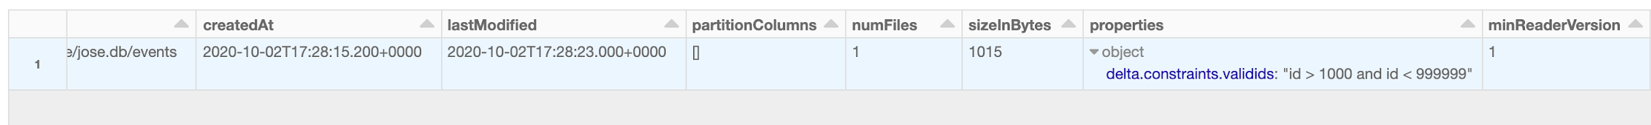
CHECK Constraint
ALTER TABLE events ADD CONSTRAINT validIds CHECK (id > 1000 and id < 999999);
DESCRIBE DETAIL events;
https://docs.microsoft.com/en-us/azure/databricks/delta/delta-constraints
CHECK constraints appear as table properties in the output of the DESCRIBE DETAIL and SHOW TBLPROPERTIES commands.
Key Features

Slide 50
Pessimistic vs. optimistic concurrency
Pessimistic Concurrency
Block others from conflicting (locks)
Optimistic Concurrency
Assume it’ll be okay and check
✔Avoid wasted work
❌Distributed locks
✔Mutual exclusion is enough!
❌Breaks down if there are a lot of conflicts

Slide 51
Solving conflicts optimistically
Record start version
Record reads/writes
If someone else wins, check if anything you read has changed
Try again.
User 1
R: Schema
W: A
000000.json
000001.json
000002.json
User 2
R: Schema
W: B

Slide 52

Checkpoints as data
Transaction log considered data
JSON files will be checkpointed into parquet snapshots
Transaction log is kept on cluster as cached RDD
Add 1.parquet
Add 2.parquet
Checkpoint
Remove 1.parquet
Remove 2.parquet
Add 3.parquet

Slide 53
Auto Loader

Slide 54
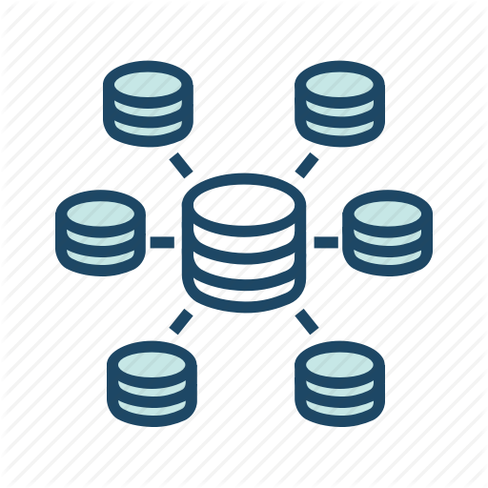




Databricks Ingest: Auto Loader
Load new data easily and efficiently as it arrives in cloud storage
Before
After
Notification Service
Message Queue
Auto Loader
Stream
Batch
CSV,
JSON, TXT…
Data Lake
Delayed schedule
Pipe data from cloud storage into your data lake with Delta Lake as it arrives
“Set and forget” model eliminates complex setup
External Trigger
Airflow file sensor
Gets too complicated for multiple jobs
Launch Blog Post
Notes:
Note: this feature was previously known as “auto ingestion”.
PRD: https://docs.google.com/document/d/1nX-OBwOzQyW_AiMtaqWJPHpvgo1ECvY7x2JWykNlYeE/edit#
1. Link to aha! feature: https://databricks.aha.io/features/DB-2449
2. What bullet of the summary slide does this connect to:
Auto Data Loader
3. Cloud:
AWS, Azure
4. Deployment (MT, ST, Azure):
All
5. Quick description of the feature:
While reading from S3 or ADLS, you can setup a streaming job and use a special data source.
As data lands in S3 or ADLS, users follow one of the below approaches to trigger their Spark jobs:
(a) delayed batch schedule: Data lands at midnight. A job is scheduled at 3am. Introduces pipeline delays.
(b) External trigger through Airflow or Lambda. Complicated setup. When there are lot of jobs, managing them becomes a pain.
(c) For streaming use cases (ex: firehose dumping data to s3), users use file source to stream from S3 or ADLS. Its inefficient and requires complicated setup.
6. Value of the feature (aka what databricks was before this feature, and what this feature will do for databricks)
Auto-loader eliminates all of these complexities for you.

Slide 55
Auto Loader - How it works
val df = spark.readStream.format("cloudFiles")
.option(“cloudFiles.includeExistingFiles”, false)
.option("cloudFiles.format", "json")
.schema(...)
.load("/input/path")
df.writeStream
.format("delta")
.option("checkpointLocation", "/checkpoint/path")
.start("/out/path")
https://docs.microsoft.com/en-us/azure/databricks/spark/latest/structured-streaming/auto-loader

Slide 56
Auto Loader
No Custom State Management: Incrementally process new files as they land on cloud object storage. No need to manage any state information on what files arrived.
Scalable: Efficiently track the new files arriving by leveraging AQS/SQS-SNS without having to list all the files in a directory. Scalable to handle millions of files in a directory
Easy to use: Automatically sets up AQS/SQS-SNS required
https://docs.microsoft.com/en-us/azure/databricks/spark/latest/structured-streaming/auto-loader

Slide 57
Delta Performance Optimization - Break down
Notes:
Let’s see how OPTIMIZE and ZORDERing improves Data Skipping

Slide 58
Questions for better optimisation
What is the size of my table?
At what frequency is my table refreshed?
Is my table broad? (having hundreds of columns)
Am I going to perform merge on my table?
Do I have low cardinal, evenly distributed column in my table for partitioning?
Notes:
The size of your table is definitely a factor for setting your table properties for optimum performance
If your table is append-only, then it might require minimum optimisation as most of the optimization will be aimed at improving the read performance of your tables
If your table involves merge, the write performance of your table will be severely impacted. Hence having the optimum configuration/table properties is critical for getting the best performance
Frequency of the table being refreshed is also vital and influences strategy around performance optimization
Selecting the best partition column is also very critical. It is better not to select a partition column than to select a wrong partition column
Long tables (with hundreds of columns) also impacts performance. Setting too small max size for target file or optimize will result in tiny files problem.

Slide 59
Common Optimization techniques
Set targetFileSize/tuneFileSizesForRewrites
Set autoOptimize.optimizeWrite
Set autoOptimize.autoCompact
Run Optmize on tables
Run Z-Order on specific columns on tables
Run Vacuum periodically to remove older versions of files
Spark configs

Slide 60
TargetFileSize / tuneFileSizesForRewrites
TuneFileSizesForRewrites:
Ideally, set the property tuneFileSizesForRewrites to true for tables that are merge intensive. This property automatically adjusts the targetFileSize based on the size of your table
TargetFileSize:
targetFileSize is a table property that can be set to any value while creating/altering a delta table. This can be set explicitly to override the above configuration.

Slide 61
Auto Optimize
Consists of 2 complementary features
Optimized writes:
Databricks dynamically optimizes Apache Spark partition sizes based on the actual data, and attempts to write out 128 MB files for each table partition. This is an approximate size and can vary depending on dataset characteristics.
Auto Compaction:
After an individual write, Databricks checks if files can further be compacted, and runs a quick OPTIMIZE job (with 128 MB file sizes instead of 1GB) to further compact files for partitions that have the most number of small files.
https://docs.microsoft.com/en-us/azure/databricks/delta/optimizations/auto-optimize

Slide 62
Compaction
How OPTIMIZE Works
OPTIMIZE my_table
OPTIMIZE customers -- Delta table
OPTIMIZE delta.`path/to/table`
Key Features
Solves the “small files problem”
Automatic (with conf setting)
https://docs.microsoft.com/en-us/azure/databricks/delta/optimizations/file-mgmt
Notes:
Who’s heard of the small files problem?
Essentially, small files are really bad for big data
If you have too many small files you will spend more time listing, opening and closing them than you will reading them.
The likelihood is, if you have streaming workloads, they’re going to be writing out a ton of small files
Big files can be a problem too- if files are too big they’re not particularly efficient to read, and depending on the file format may not be parallelizable
The sweet spot is somewhere in between
Delta can really help here
Via the OPTIMIZE command, Delta will compact all of the files in your data lake to a consistent, optimal size, improving query speeds by orders of magnitude]
70 billion records- 3.17 hours to 30.13 mins following an OPTIMIZE

Slide 63

Z-Ordering
Z-Ordering is a multidimensional clustering technique, whereby data is co-located in order to optimize the efficiency of data skipping
SELECT ... FROM customers WHERE date_registered <= 2014-01-01
AND total_orders >= 100
Key Features
Safely skip more data
Much faster queries
Range partitions data
2013-12-31
2014-01-01
2014-01-02
https://docs.microsoft.com/en-us/azure/databricks/delta/optimizations/file-mgmt#--z-ordering-multi-dimensional-clustering
Notes:
Well, in Delta we can, thanks to Zordering
Which is a multidimensional clustering technique that we optimize with a load of complicated algorithms like gradient descent
But essentially it means that Delta will co-locate statistically similar data in order to maximise the efficiency of data skipping

Slide 64
What feature are we talking about?
OPTIMIZE events WHERE date >= current_timestamp() - INTERVAL 1 day ZORDER BY (eventType)

Slide 65
Auto Optimize
Automatically compact small files during individual writes to a Delta table
Traditional Writes
Optimized Writes
Executors
Executors
...
...
Adaptive Shuffle
...
partition#1
Files in Delta Tables
partition#n
partition#1
partition#n
Files in Delta Tables
NOTE: Auto Optimize performs compaction only on small files; doesn’t Z-Order the files.
How to configure
Notes:
Intro
Paying a small cost during writes offers significant benefits for tables that are queried actively.
Auto Optimize is particularly useful in the following scenarios:
Streaming use cases where latency in the order of minutes is acceptable
MERGE INTO is the preferred method of writing into Delta Lake
CREATE TABLE AS SELECT or INSERT INTO are commonly used operations
How Auto Optimize works
Auto Optimize consists of two complementary features: Optimized Writes and Auto Compaction.
Optimized Writes
Azure Databricks dynamically optimizes Apache Spark partition sizes based on the actual data, and attempts to write out 128 MB files for each table partition. This is an approximate size and can vary depending on dataset characteristics.
Auto Compaction
After an individual write, Azure Databricks checks if files can further be compacted, and runs a quick OPTIMIZE job (with 128 MB file sizes instead of 1GB) to further compact files for partitions that have the most number of small files.

Slide 66
Auto Optimize - How it works
For existing tables:
%sql
ALTER TABLE [table_name | delta.`<table-path>`]
SET TBLPROPERTIES (delta.autoOptimize.optimizeWrite = true,
delta.autoOptimize.autoCompact = true);
To ensure all new Delta tables have these features enabled:
%sql
SET spark.databricks.delta.properties.defaults.autoOptimize.optimizeWrite = true;
SET spark.databricks.delta.properties.defaults.autoOptimize.autoCompact = true;
This feature can be enabled / disabled for a SparkSession with config:
spark.databricks.delta.optimizeWrite.enabled
spark.databricks.delta.autoCompact.enabled
https://docs.microsoft.com/en-us/azure/databricks/delta/optimizations/auto-optimize

Slide 67
Time Travel and Restore

Slide 68
Table history
Key Features
An “audit log” of changes to your data
See who changed what, when
Syntax
DESCRIBE HISTORY customers -- Delta table
DESCRIBE HISTORY delta.`path/to/table`
https://docs.microsoft.com/en-us/azure/databricks/delta/delta-utility#delta-history
Notes:
Using the DESCRIBE HISTORY command we can get a summarised view of all of the changes that have been made to our table.
We’ll see an example of this and how it might be used in the demo

Slide 69
Time Travel
Key Features
Perform “point in time” queries on your data
See how it has evolved over time
Syntax
Time travel
(implicit snapshots)
customers
customers
customers
p1
p1
p1
TX log
p2
TX log
p2
TX log
p2
p3
p3
p3
p4
✘
✘
p4
p4
V0
V1
V2
SELECT *
FROM customers -- Delta table
TIMESTAMP AS OF [timestamp_expression]
SELECT *
FROM customers -- Delta table
VERSION AS OF [version]
https://docs.microsoft.com/en-us/azure/databricks/delta/delta-batch#deltatimetravel
Notes:
And we can use that to perform “point in time” queries of our data and see how it has evolved over time
timestamp_expression can be any one of:
A string that can be cast to a timestamp- I.e. '2018-10-18T22:15:12.013Z',
A string that can be cast as a date- I.e. '2018-10-18'
A cast that you handle yourself- I.e. cast(‘2018-10-18 13:36:32 CEST’ as timestamp)
An sql expression- I.e. current_timestamp() - interval 12 hours or date_sub(current_date(), 1)
Any other expression that is or can be cast to a timestamp

Slide 70
RESTORE a Delta table
RESTORE TABLE delta.`path/to/source_table` TO TIMESTAMP AS OF <timestamp>
DeltaTable
.forName("spark", "customers")
.restoreToVersion(123)
https://docs.microsoft.com/en-us/azure/databricks/delta/delta-utility#restore-delta-table
Key Features
Restores a Delta table to an earlier state.
Restoring to an earlier version number or a timestamp is supported.
Restoring a table to an older version where the data files were deleted manually or by vacuum will fail.

Slide 71
Time Travel
Reproduce experiments & reports
Rollback accidental bad writes
RESTORE TABLE events TO TIMESTAMP AS OF 2020-01-18;
RESTORE TABLE events TO VERSION AS OF 123;
SELECT count(*) FROM events TIMESTAMP AS OF timestamp;
SELECT count(*) FROM events VERSION AS OF version;
spark.read.format("delta").option("timestampAsOf", timestamp_string).load("/events/")

Slide 72
Change Data Capture

Slide 73

Getting started with Delta Change Data Feed
Enable CDF on TABLE…
… or Establish CDF on CLUSTER
ALTER TABLE ...
SET TBLPROPERTIES (delta.enableChangeDataCapture = true);
spark.conf.set(”spark.databricks.delta.properties.defaults.enableChangeDataCapture”, ”true”)
in SQL, Python, or Scala
in Python, or Scala
Notes:
https://databricks.com/discover/getting-started-with-delta-lake-tech-talks

Slide 74
Using Delta Change Data Feed
Query changes…
… and store them
SELECT … FROM table_changes('tableName',
startingVersion
[,endingVersion])
or
SELECT … FROM table_changes('tableName',
'startingTimestamp'
[,'endingTimestamp'])
INSERT INTO TABLE ...
USING delta ...
as
SELECT … FROM table_changes(...)
in SQL, Python, or Scala

Slide 75
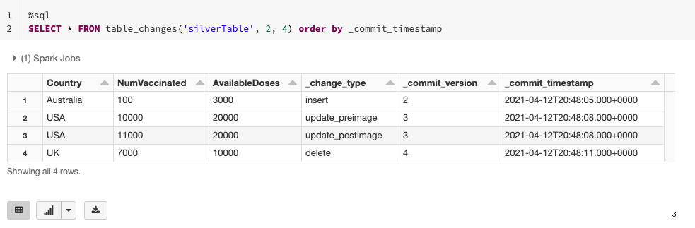
Getting started with Delta Change Data Feed

Slide 76
Best Practices

Slide 77
Best Practices - Delta
Always try to follow the medallion approach
The Bronze layer must accept all data invariably (schema evolution)
The silver and gold layers can have stricter schema enforcement
Enable change data feed in silver layer (merge intensive)
Use autoOptimize.optimizeWrite property whenever possible
Schedule vacuum on your tables periodically
Run Optimize and ZOrder as separate jobs and not as part of BAU
Choose the right partition columns for your tables
Notes:
The size of your table is definitely a factor for setting your table properties for optimum performance
If your table is append-only, then it might require minimum optimisation as most of the optimization will be aimed at improving the read performance of your tables
If your table involves merge, the write performance of your table will be severely impacted. Hence having the optimum configuration/table properties is critical for getting the best performance
Frequency of the table being refreshed is also vital and influences strategy around performance optimization
Selecting the best partition column is also very critical. It is better not to select a partition column than to select a wrong partition column
Long tables (with hundreds of columns) also impacts performance. Setting too small max size for target file or optimize will result in tiny files problem.

Slide 78
Best Practices
Develop scalable, modular code (define methods)
Organize your notebooks into defined folder structures
Parameterise (widgets) your input variables to your notebook
Write at least one unit test case for each method
Use a repository management tool (git, devops, bitbucket)
Deploy using CI/CD tools like jenkins, azure devops
Notes:
The size of your table is definitely a factor for setting your table properties for optimum performance
If your table is append-only, then it might require minimum optimisation as most of the optimization will be aimed at improving the read performance of your tables
If your table involves merge, the write performance of your table will be severely impacted. Hence having the optimum configuration/table properties is critical for getting the best performance
Frequency of the table being refreshed is also vital and influences strategy around performance optimization
Selecting the best partition column is also very critical. It is better not to select a partition column than to select a wrong partition column
Long tables (with hundreds of columns) also impacts performance. Setting too small max size for target file or optimize will result in tiny files problem.

Slide 79
Relevant links to documentation and references

Slide 80
Docs and Talks
Documentation and best practices references
Delta Lake Guide
Delta Open Source Project
Various optimizations in Delta Lake
Delta Lake Concurrency Control
Z-order curve
Delta Streaming reads and writes
Delta Lake MERGE
Auto Loader
Talks:
Threat Detection and Response at Scale (Apple)
Winning the Audience with AI: How Comcast Built An Agile Data And Ai Platform At Scale (Comcast)
Building Robust Production Data Pipelines with Databricks Delta
Designing and Building Next Generation Data Pipelines at Scale with Structured Streaming
Apache Spark Core – Practical Optimization
Tech Talk series: Diving into Delta Lake

Slide 81
Blogs
Auto Loader
Efficient Upserts into Data Lakes using Databricks Delta
New Databricks Delta Features Simplify Data Pipelines
Introducing Delta Time Travel for Large Scale Data Lakes
Simplifying Change Data Capture with Databricks Delta
Building a Real-Time Attribution Pipeline with Databricks Delta
Processing Petabytes of Data in Seconds with Databricks Delta
Simplifying Streaming Stock Data Analysis Using Databricks Delta
Make Your Oil and Gas Assets Smarter by Implementing Predictive Maintenance with Databricks
Build a Mobile Gaming Events Data Pipeline with Databricks Delta
Delta Lake tagged blogs
Diving Into Delta Lake: Unpacking The Transaction Log
Preview of DBR 7.0 and Apache Spark 3.0

Slide 82
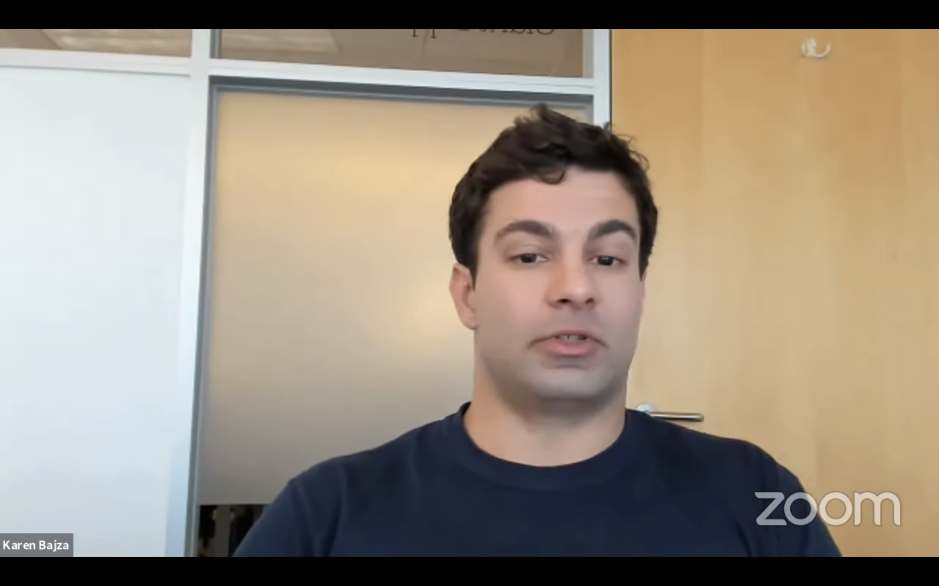
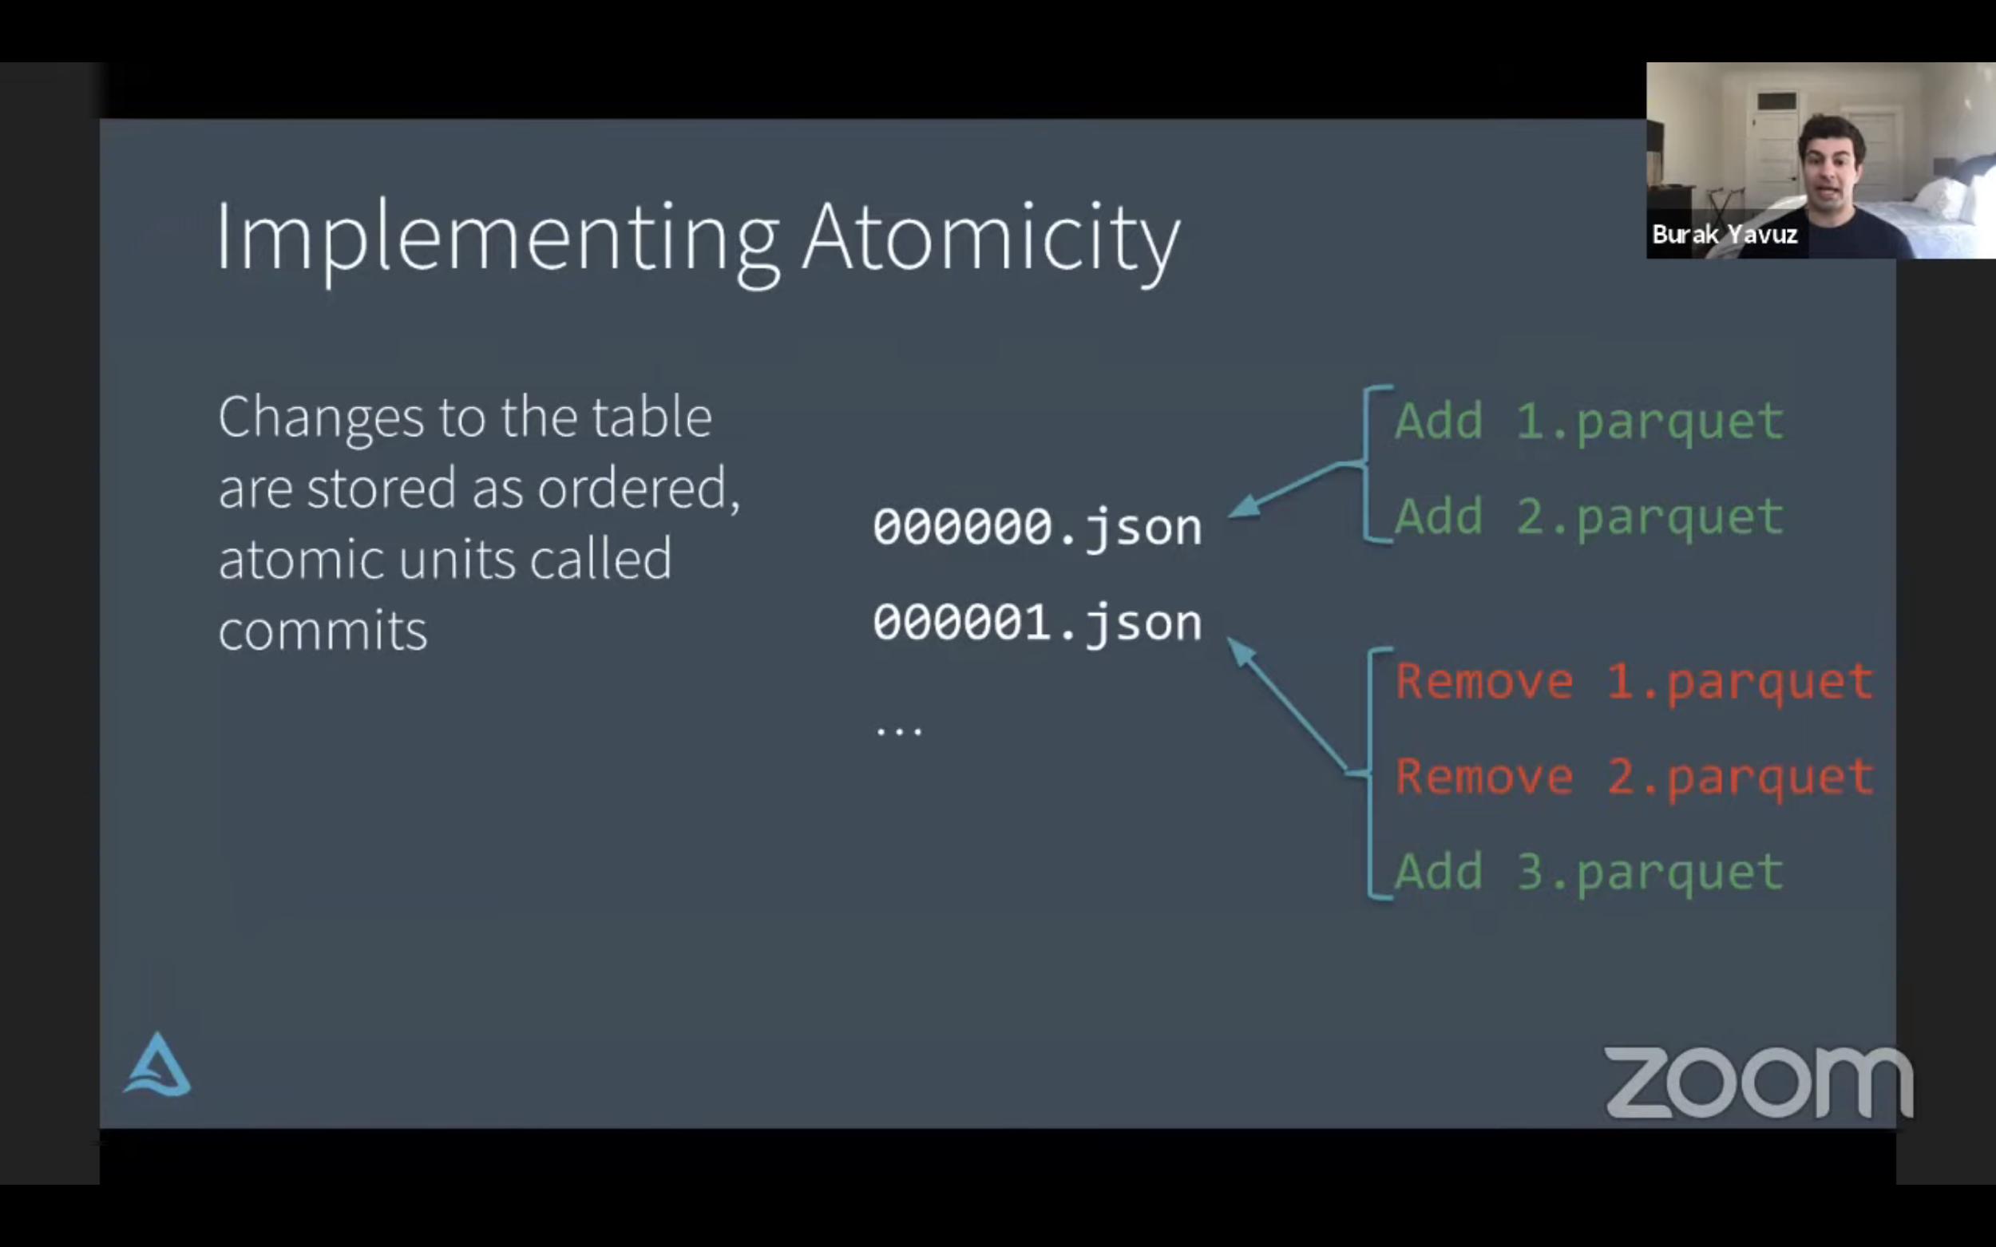
Webinars - YouTube playlist
Tech Talk | The Genesis of Delta Lake - An Interview with Burak Yavuz
https://youtu.be/F-5t3QCI96g
Tech Talk | Diving into Delta Lake Part 1: Unpacking the Transaction Log
https://youtu.be/F91G4RoA8is

Slide 83
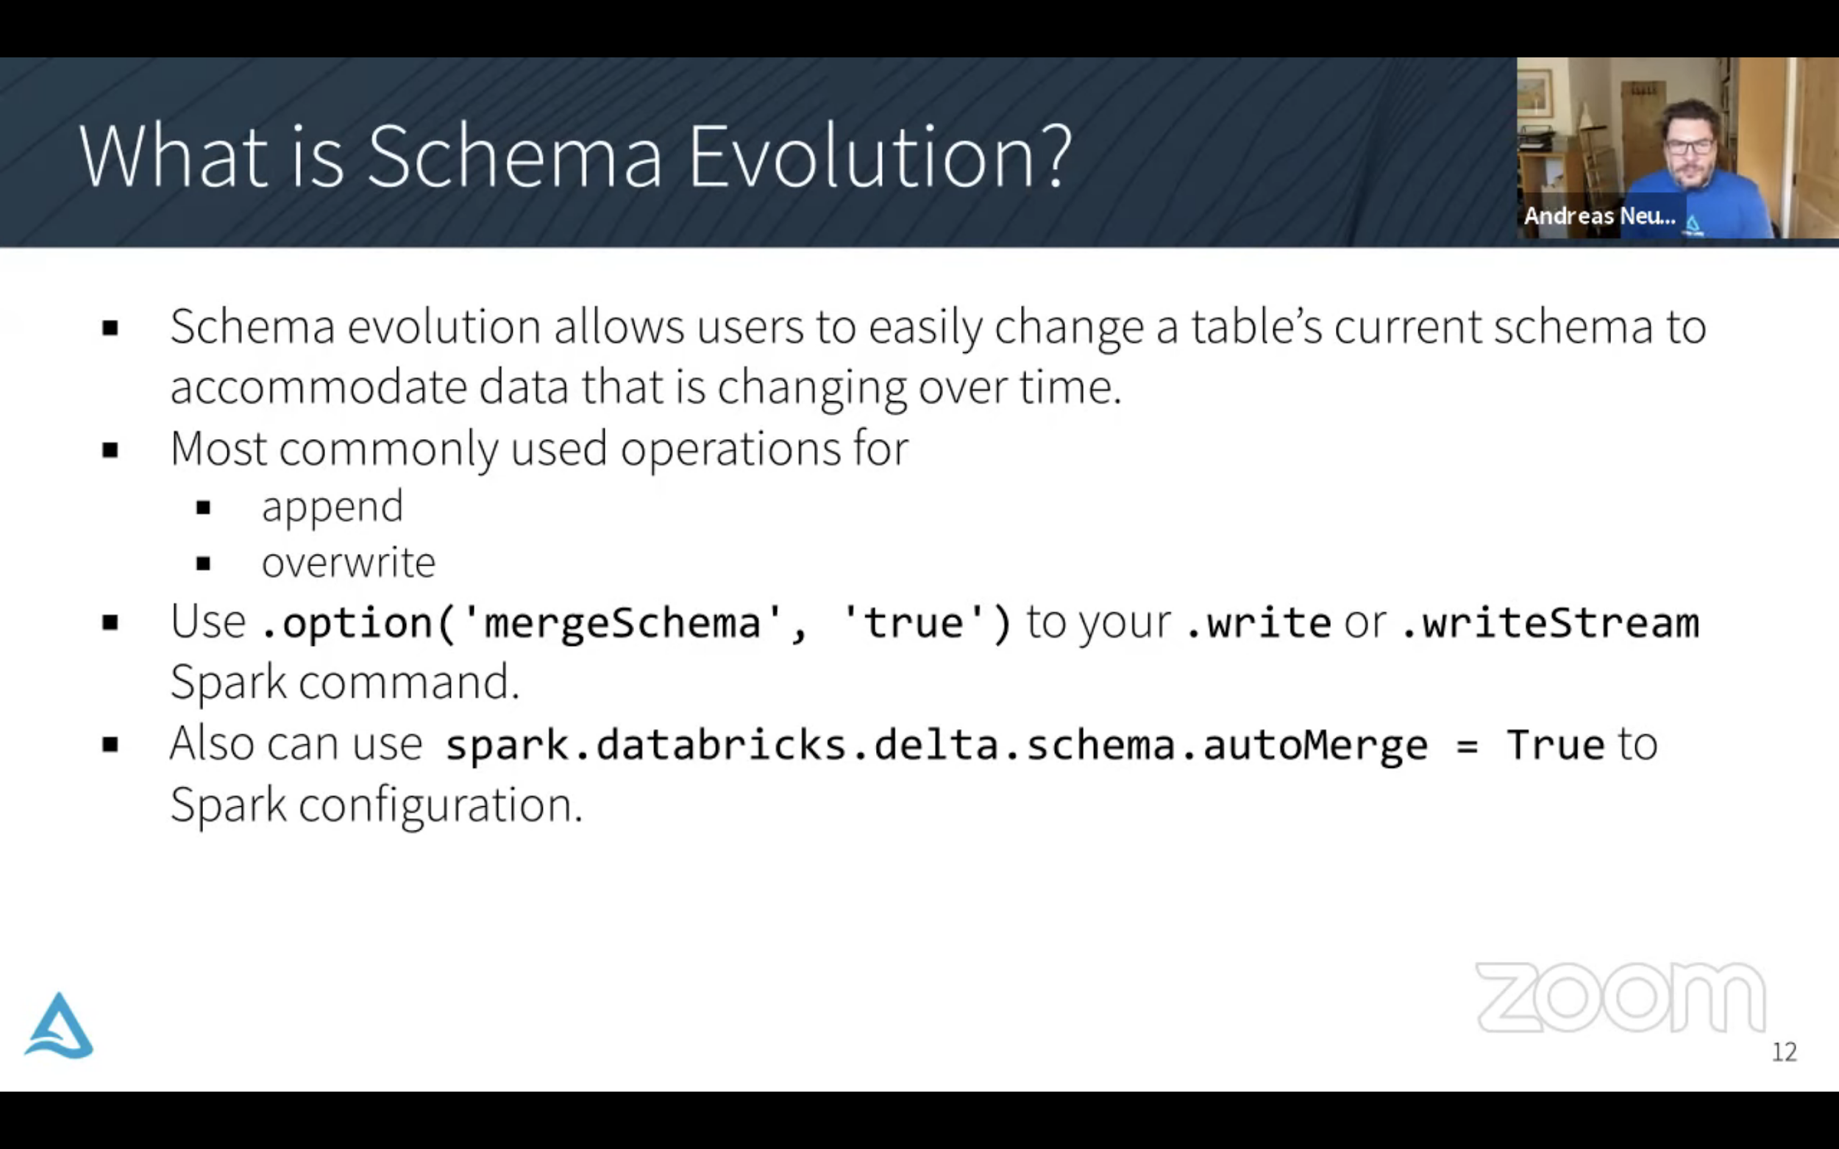
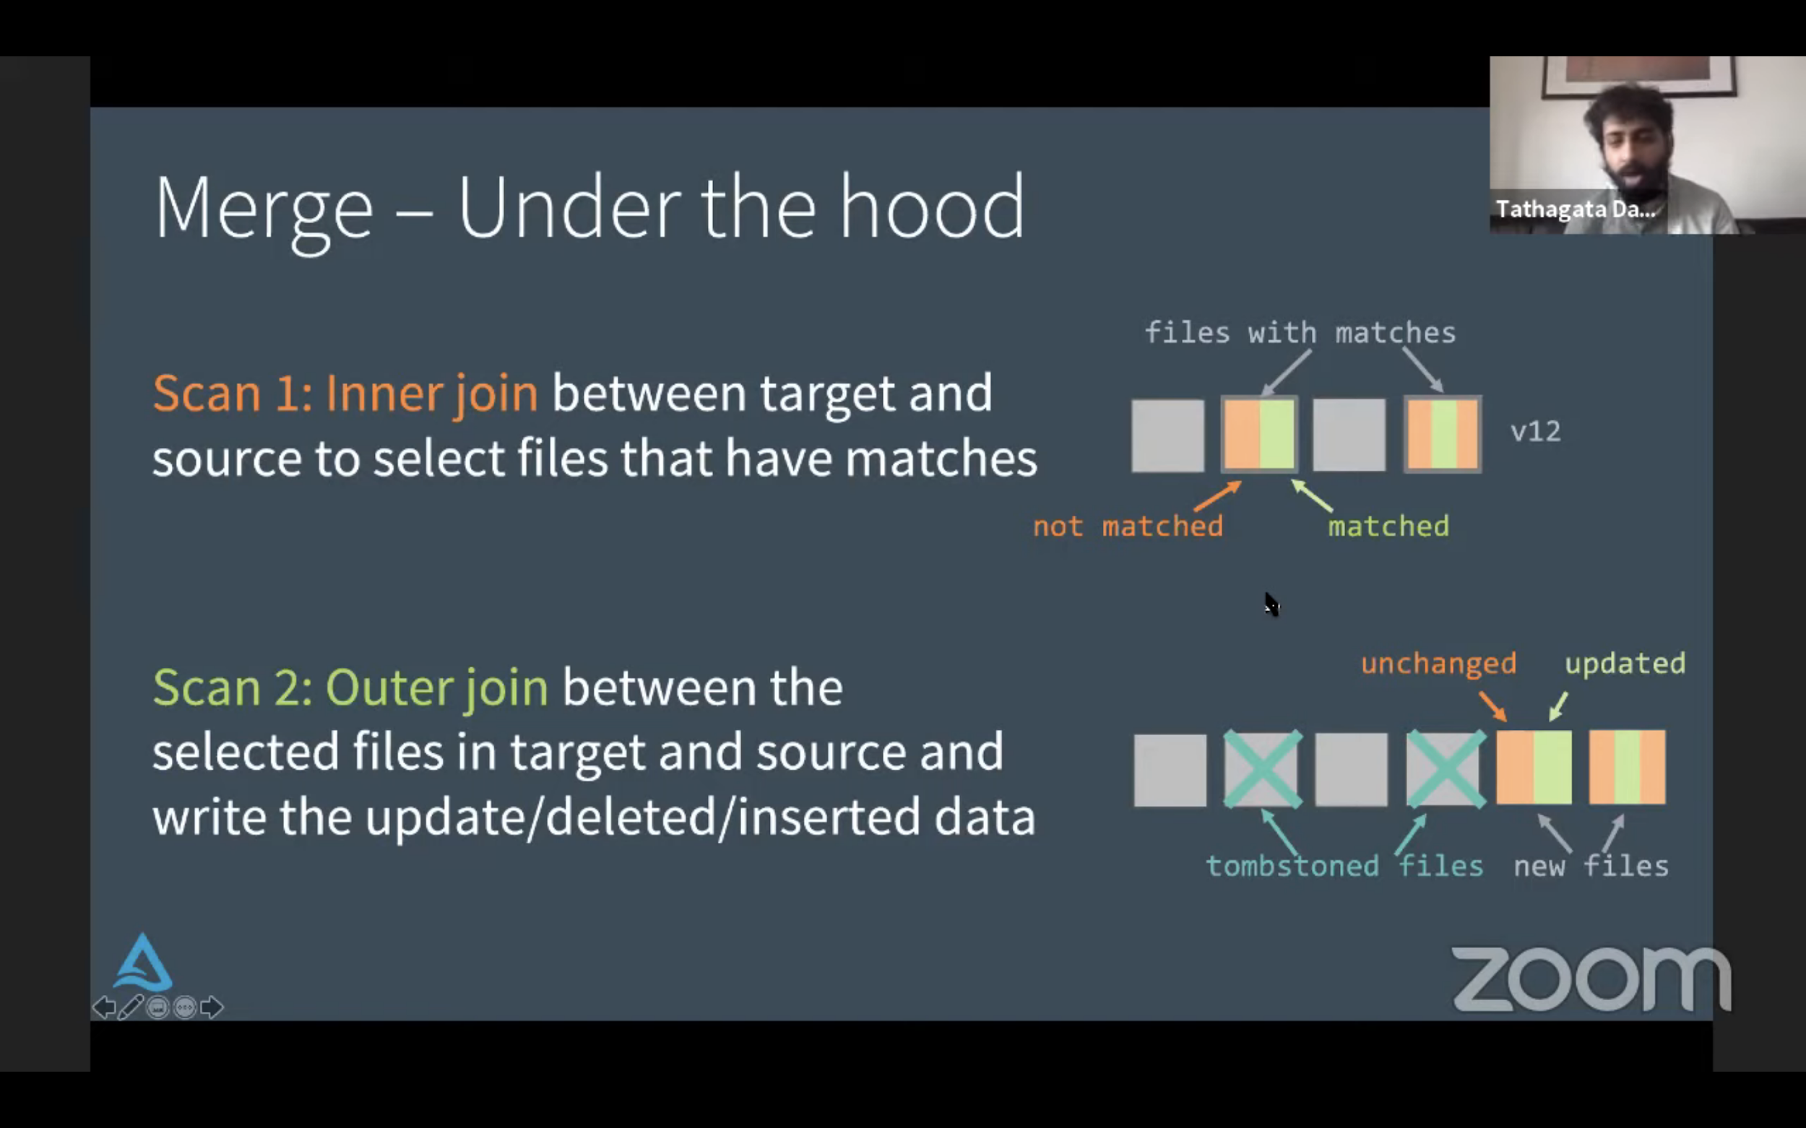
Webinars - YouTube playlist
Tech Talk | Diving into Delta Lake Part 2: Enforcing and Evolving the Schema
https://youtu.be/tjb10n5wVs8
Tech Talk | Diving into Delta Lake Part 3: How do DELETE, UPDATE, and MERGE work
https://youtu.be/7ewmcdrylsA

Slide 84
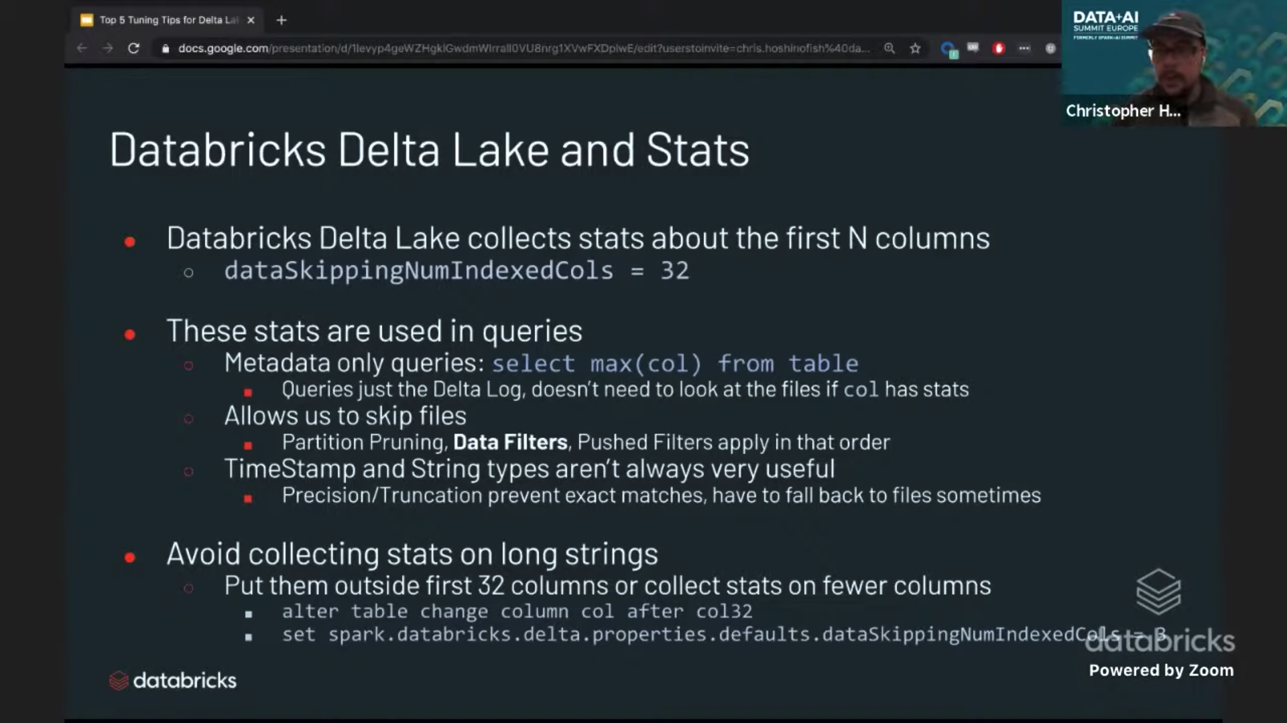
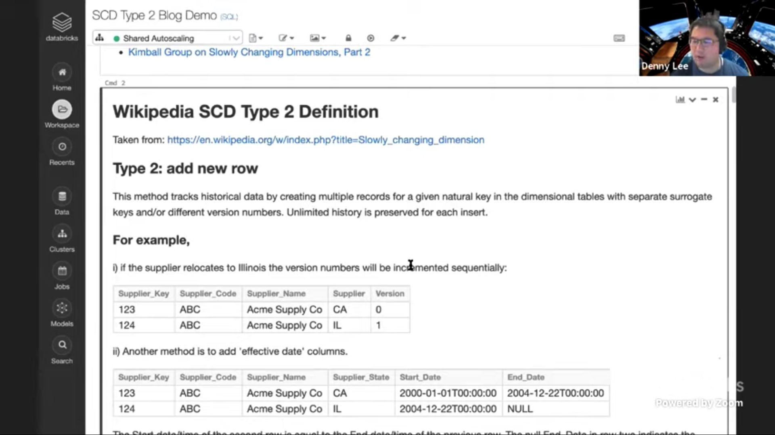
Webinars - YouTube playlist
Tech Talk | Top Tuning Tips for Spark 3.0 and Delta Lake on Databricks
https://youtu.be/hcoMHnTcvmg
Tech Chat | Slowly Changing Dimensions (SCD) Type 2
https://youtu.be/HZWwZG07hzQ

Slide 85
Self-paced Courses
https://academy.databricks.com/learning-paths
Notes:
Self-paced Courses:
https://academy.databricks.com/learning-paths

Slide 86
Thank you

